Slide 1
RSS-based localization
Emil Jousimaa & Siep Dokter
Based on: “A Hybrid WiFi/Bluetooth RSS Dataset with Application to Multilateration-Based Localization” by Giovanni Pettorru et. al

Slide 2
Index
The experimental setup
Characterisation of the dataset
Estimation parameters of the path loss model
Calculation estimator for target localisation
Weighted linear least squares method
Maximum Likelihood
Comparing the performance
BLT
WIFI
Hybrid

Slide 3
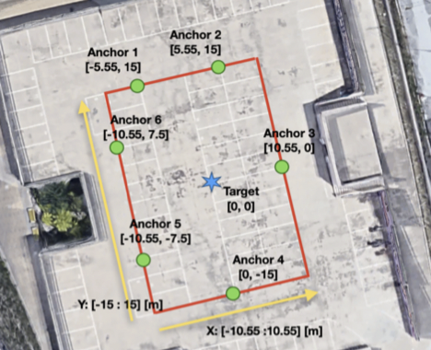
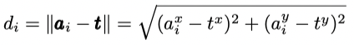
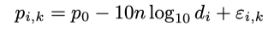
The experimental setup (A)
6 anchors
Actual distance (Euclidean metric)
Power value bursts anchors

Slide 4
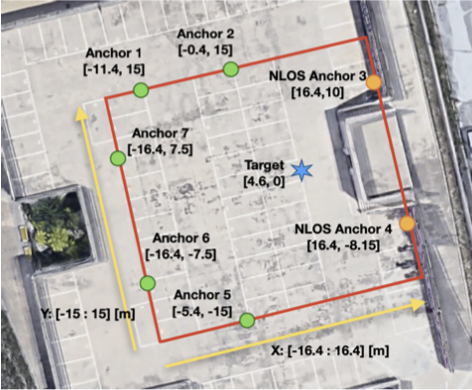
The experimental setup (B)
7 anchors
small obstruction

Slide 5
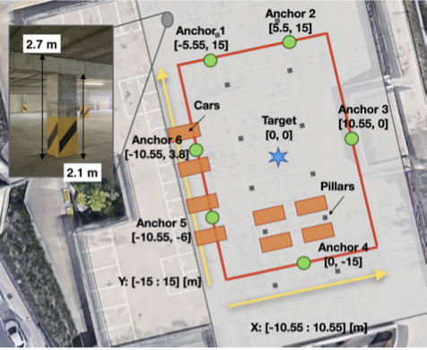
The experimental setup (C)
6 anchors
Inside
multiple obstructions

Slide 6
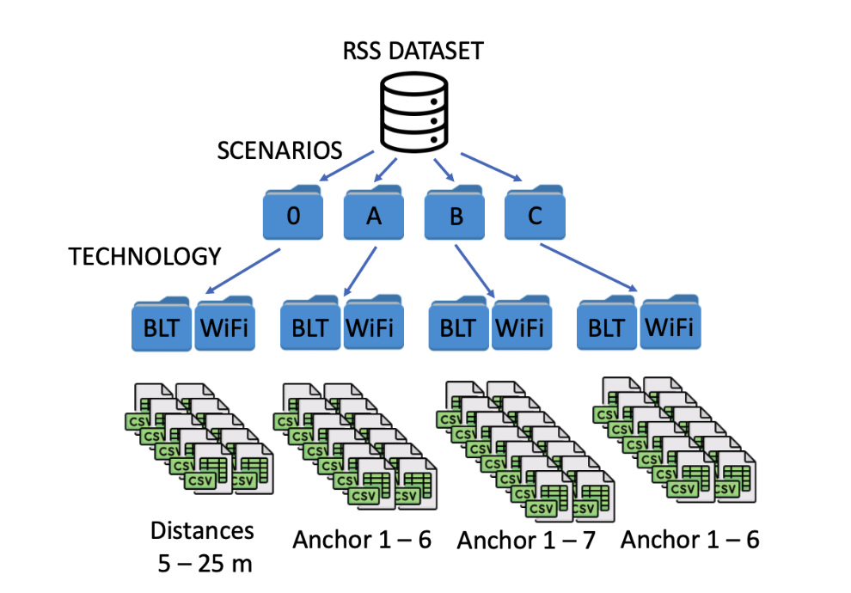
The structure of the dataset
The dataset contains three scenarios A, B and C
The scenarios contain subfolders of transmission technique (RPI or Arduino), measurement method (BLT or WiFi) and eventually the files for each Anchor.
Each transmission technique and measurement method has its own anchor files.
Also a Scenario 0 which is for preliminary analysis of the experimental environment.

Slide 7
Characterization of the dataset
The task was to do a statistical characterization of the anchors’ RSS values for each scenario.
The variables analysed were mean, median and variance.
Distribution of the RSS values between anchors was also done

Slide 8
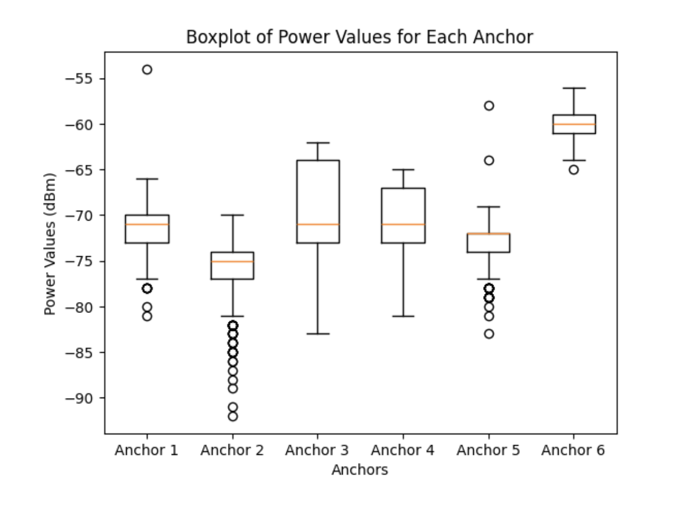
Scenario A, Bluetooth Dataset
Anchor 1:
mean: -71.32
median: -71.0
variance: 5
Anchor 2:
mean: -75.961
median: -75.0
variance: 9
Anchor 3:
mean: -69.591
median: -71.0
variance: 20
Anchor 4:
mean: -70.686
median: -71.0
variance: 12
Anchor 5:
mean: -72.958
median: -72.0
variance: 5
Anchor 6:
mean: -59.897
median: -60.0
variance: 2

Slide 9
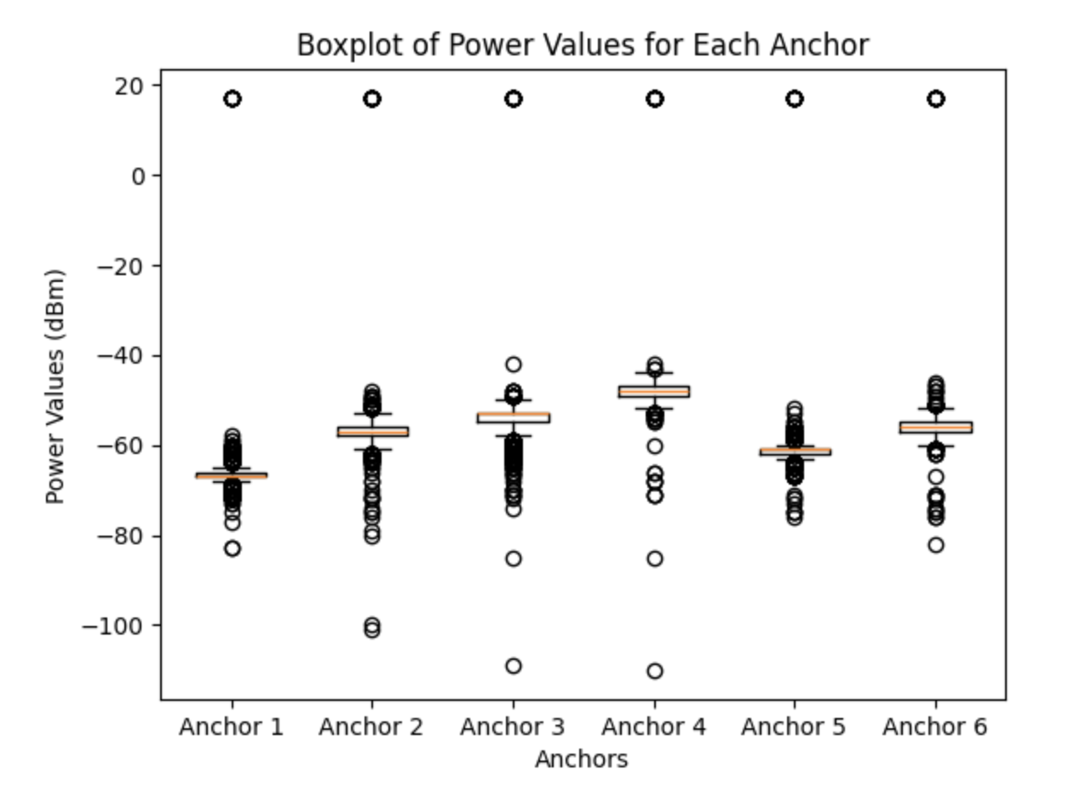
Scenario A, WiFi Dataset
Anchor 1:
mean: -65.568
median: -67.0
variance: 84
Anchor 2:
mean: -55.9
median: -57.0
variance: 112
Anchor 3:
mean: -53.419
median: -53.0
variance: 124
Anchor 4:
mean: -47.639
median: -48.0
variance: 84
Anchor 5:
mean: -60.118
median: -61.0
variance: 118
Anchor 6:
mean: -54.85
median: -56
variance: 106

Slide 10
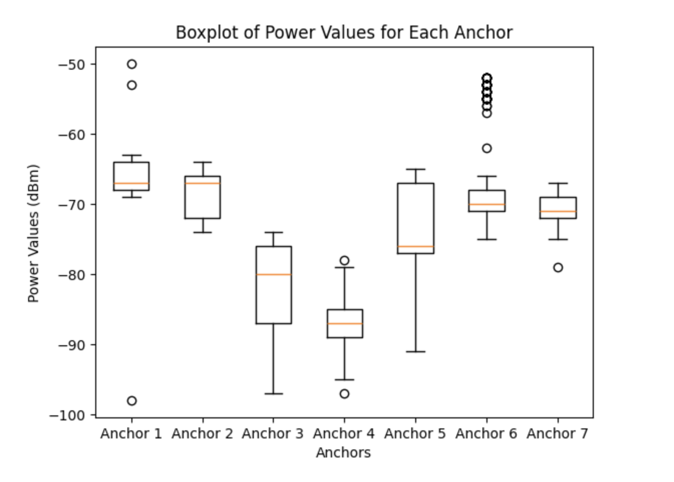
Scenario B, Bluetooth Dataset
Anchor 1:
mean: -66.426
median: -67.0
variance: 5
Anchor 2:
mean: -68.092
median: -67.0
variance: 10
Anchor 3:
mean: -81.3
median: -80.0
variance: 32
Anchor 4:
mean: -86.879
median: -87.0
variance: 9
Anchor 5:
mean: -74.092
median: -76.0
variance: 43
Anchor 6:
mean: -68.719
median: -70.0
variance: 19
Anchor 7:
mean: -70.987
median: -71.0
variance: 4

Slide 11
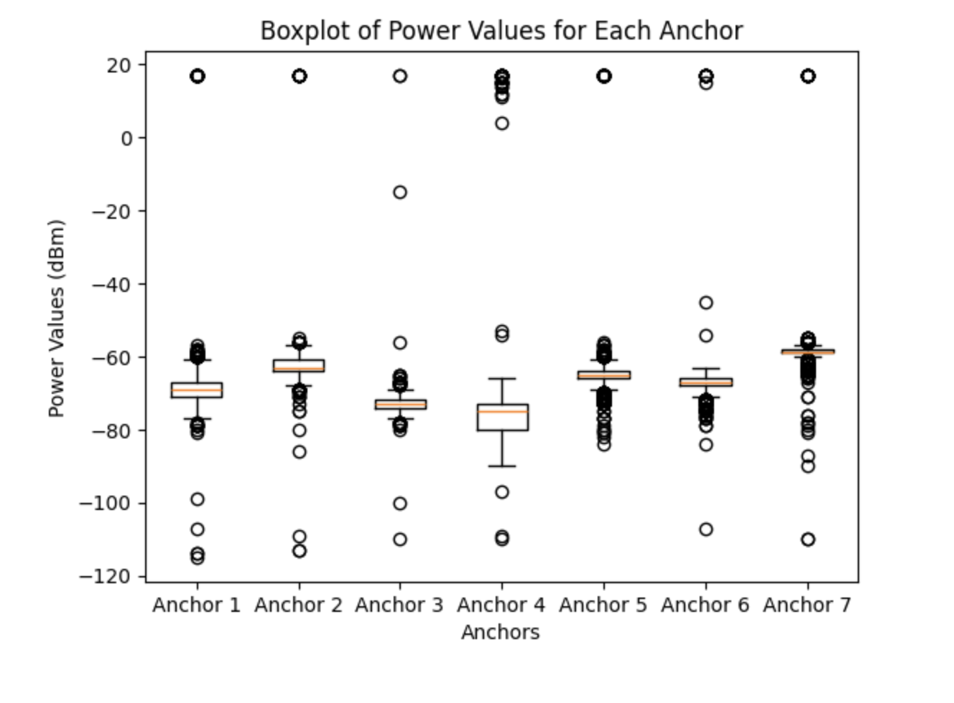
Scenario B, WiFi Dataset
Anchor 1:
mean: -66.683
median: -69.0
variance: 212
Anchor 2:
mean: -62.057
median: -63.0
variance: 83
Anchor 3:
mean: -71.467
median: -73.0
variance: 41
Anchor 4:
mean: -74.149
median: -75.0
variance: 196
Anchor 5:
mean: -63.028
median: -65.0
variance: 208
Anchor 6:
mean: -66.059
median: -67.0
variance: 105
Anchor 7:
mean: -57.873
median: -59.0
variance: 138

Slide 12
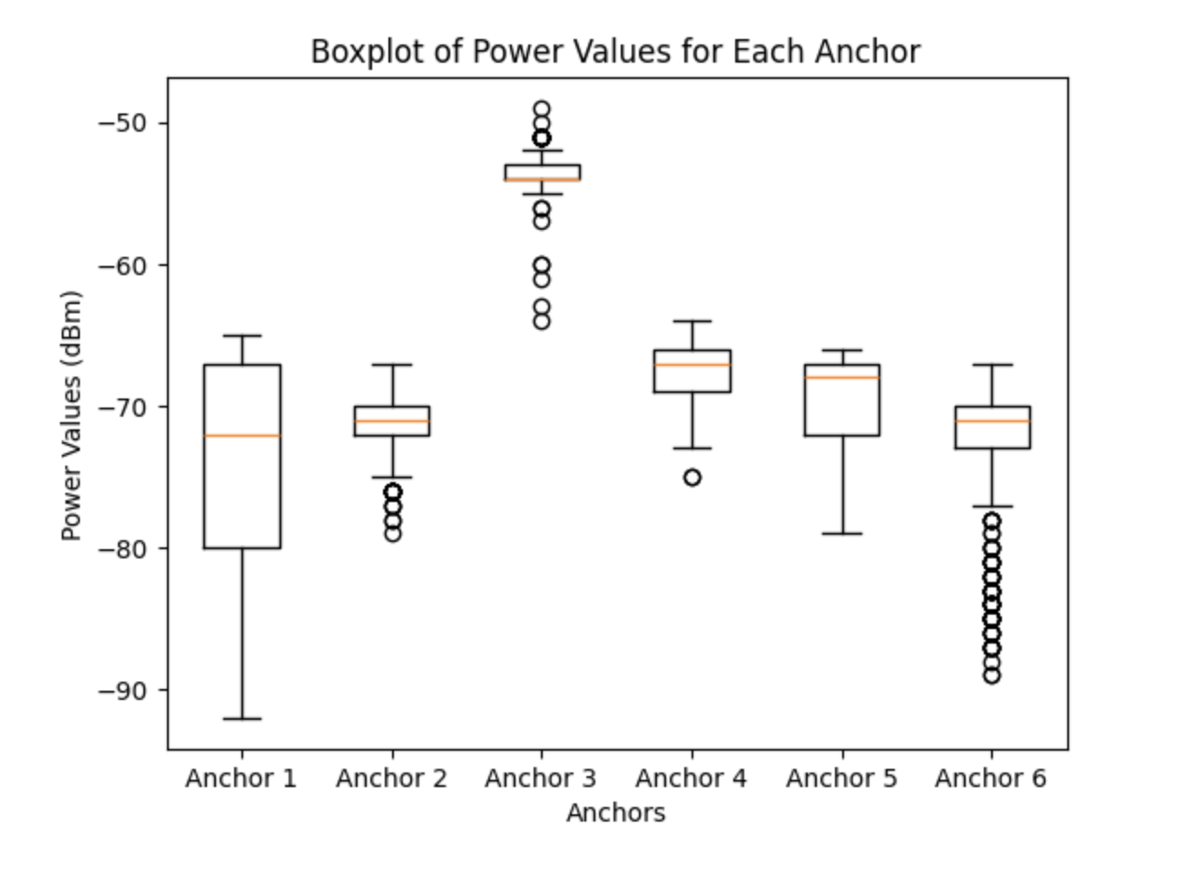
Scenario C, Bluetooth Dataset
Anchor 1:
mean: -73.259
median: -72.0
variance: 42
Anchor 2:
mean: -71.197
median: -71.0
variance: 5
Anchor 3:
mean: -53.581
median: -54.0
variance: 2
Anchor 4:
mean: -67.534
median: -67.0
variance: 4
Anchor 5:
mean: -69.583
median: -68.0
variance: 7
Anchor 6:
mean: -72.574
median: -71.0
variance: 23

Slide 13
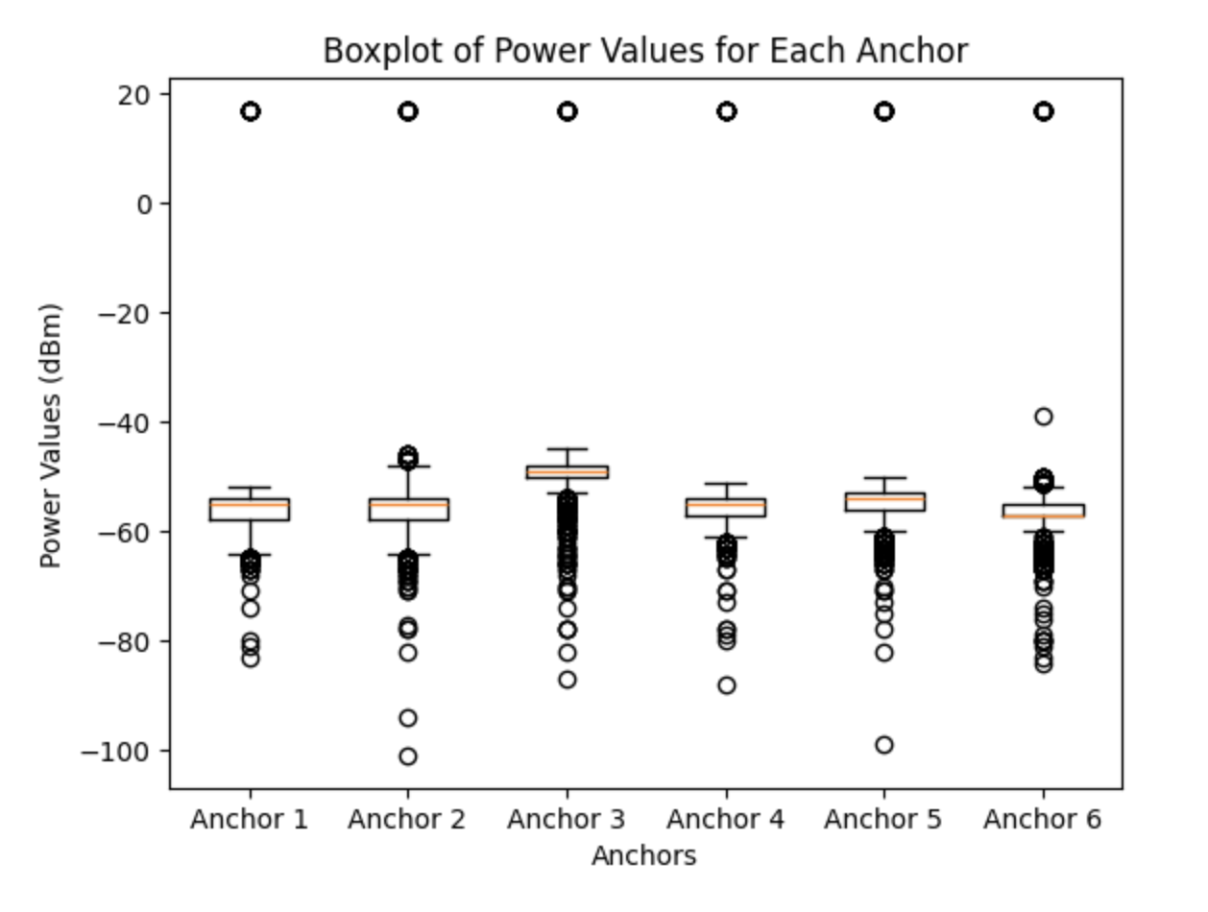
Scenario C, WiFi Dataset
Anchor 1:
mean: -55.389
median: -55.0
variance: 98
Anchor 2:
mean: -54.48
median: -55.0
variance: 141
Anchor 3:
mean: -48.453
median: -49.0
variance: 106
Anchor 4:
mean: -54.821
median: -55.0
variance: 99
Anchor 5:
mean: -53.956
median: -54.0
variance: 124
Anchor 6:
mean: -55.265
median: -57.0
variance: 139

Slide 14
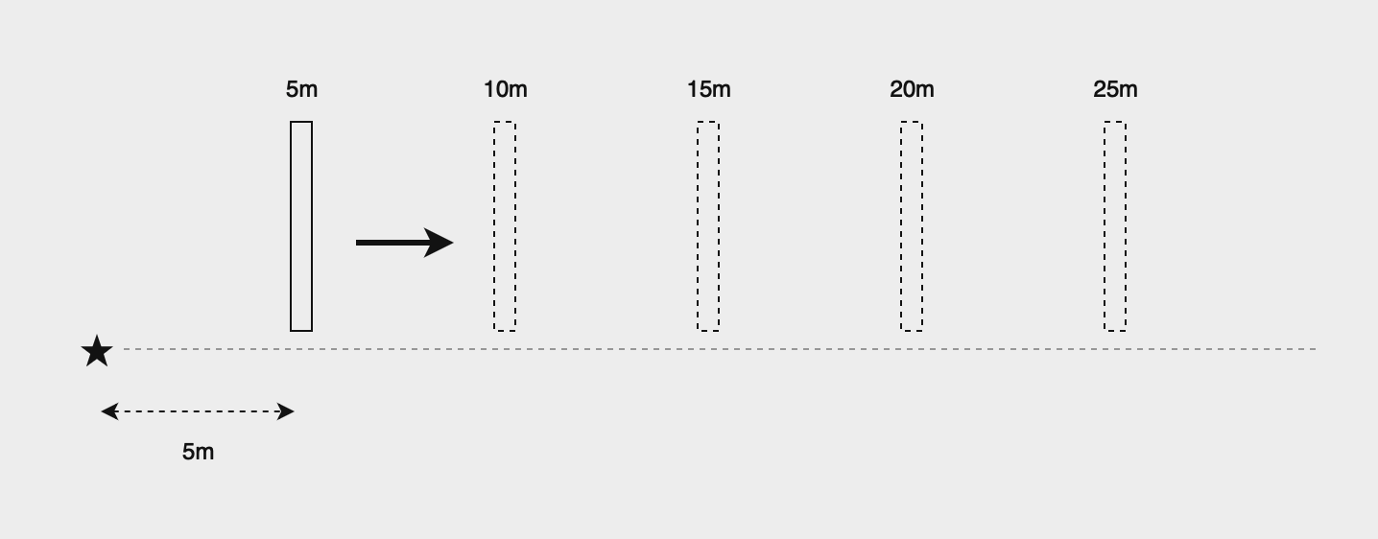
Estimation of the parameters of the path loss model (1)
The task was to estimate the path loss exponent n and the power received at the reference distance p_0
The estimation was done by applying the values of Scenario 0 to the estimator given in [2].
The experimental setup for the task

Slide 15
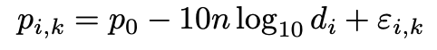
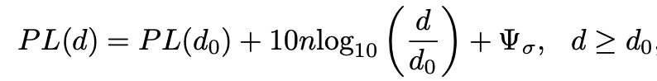
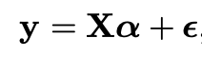
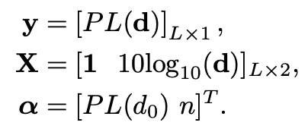
Estimation of the parameters of the path loss model (2)
Path loss model according to [1]:
Path loss model according to [2]:
that can be written as:
where,
p_0 = PL(d_0), and p_i = PL(d)
y=[PL(d)] = Vector of all the RSS values measured at different distances
In the matrix X the value d stands for the distance of the anchor.

Slide 16
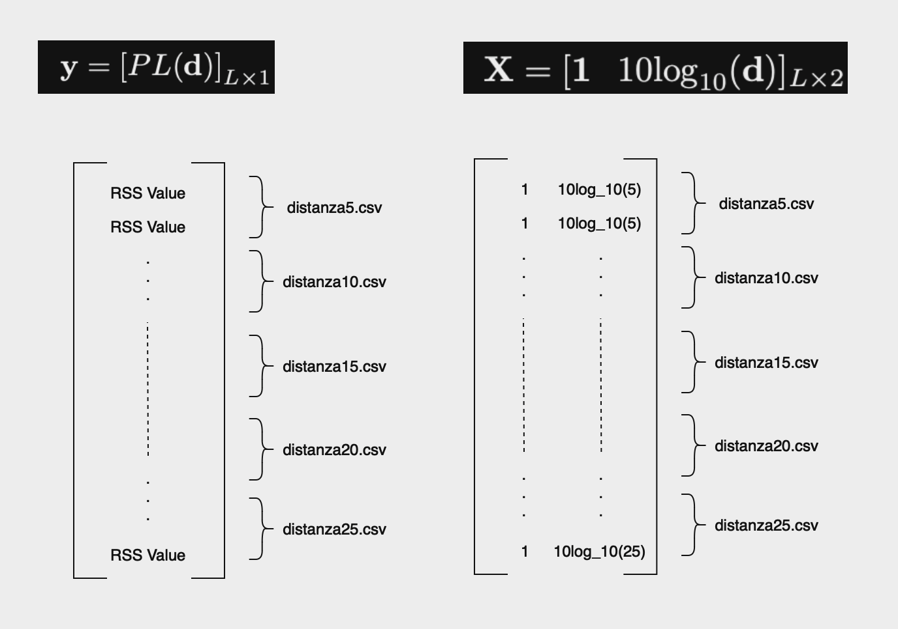
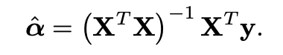
Estimation of the parameters of the path loss model (3)
Applying y and X to the estimator:
The results:
p_0 = -75.00
n = 0.3

Slide 17
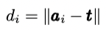
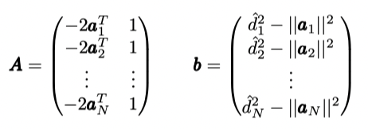
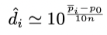
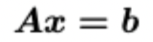
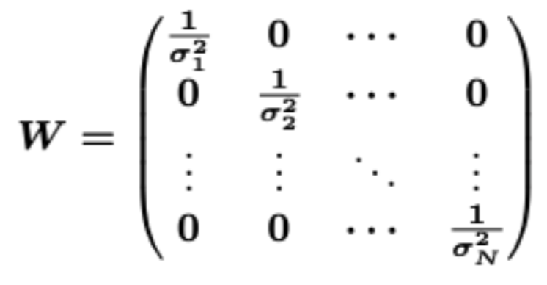
Estimator based on weighted least squares
Measure actual distance [1]
Rewriting formula path loss [1]
Squaring and rewriting makes formula
Defined as [1]
We find the variance over every burst and obtain diagonal matrix

Slide 18
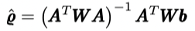
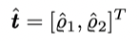
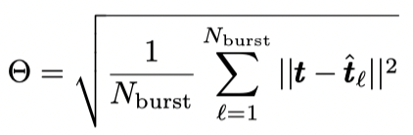
Estimator based on weighted least squares
Find the estimator [1]
Of which we obtain the x and y coordinate [1]
We compare wifi, bluetooth and hybrid with the Rooted Mean Squared Error. [1]
RMSE equation:

Slide 19
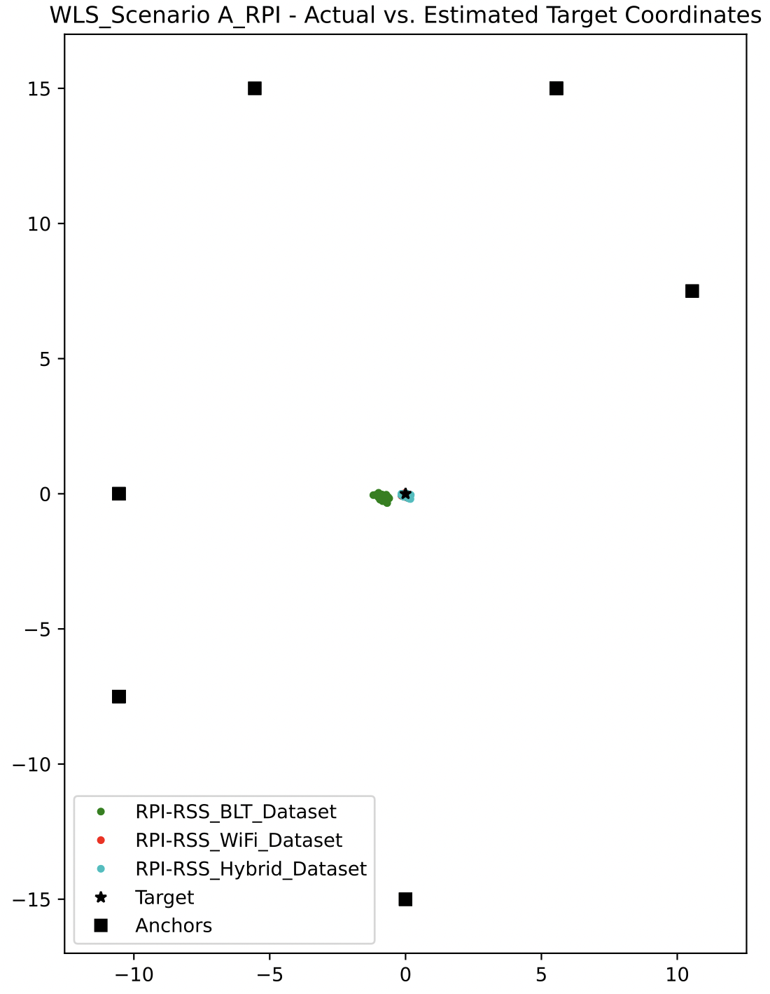
Scenario A (WLS)
RMSE comparison (m)
Wifi most accurate
BLT | WiFi | Hybrid
0.847 | 0.106 | 0.129

Slide 20
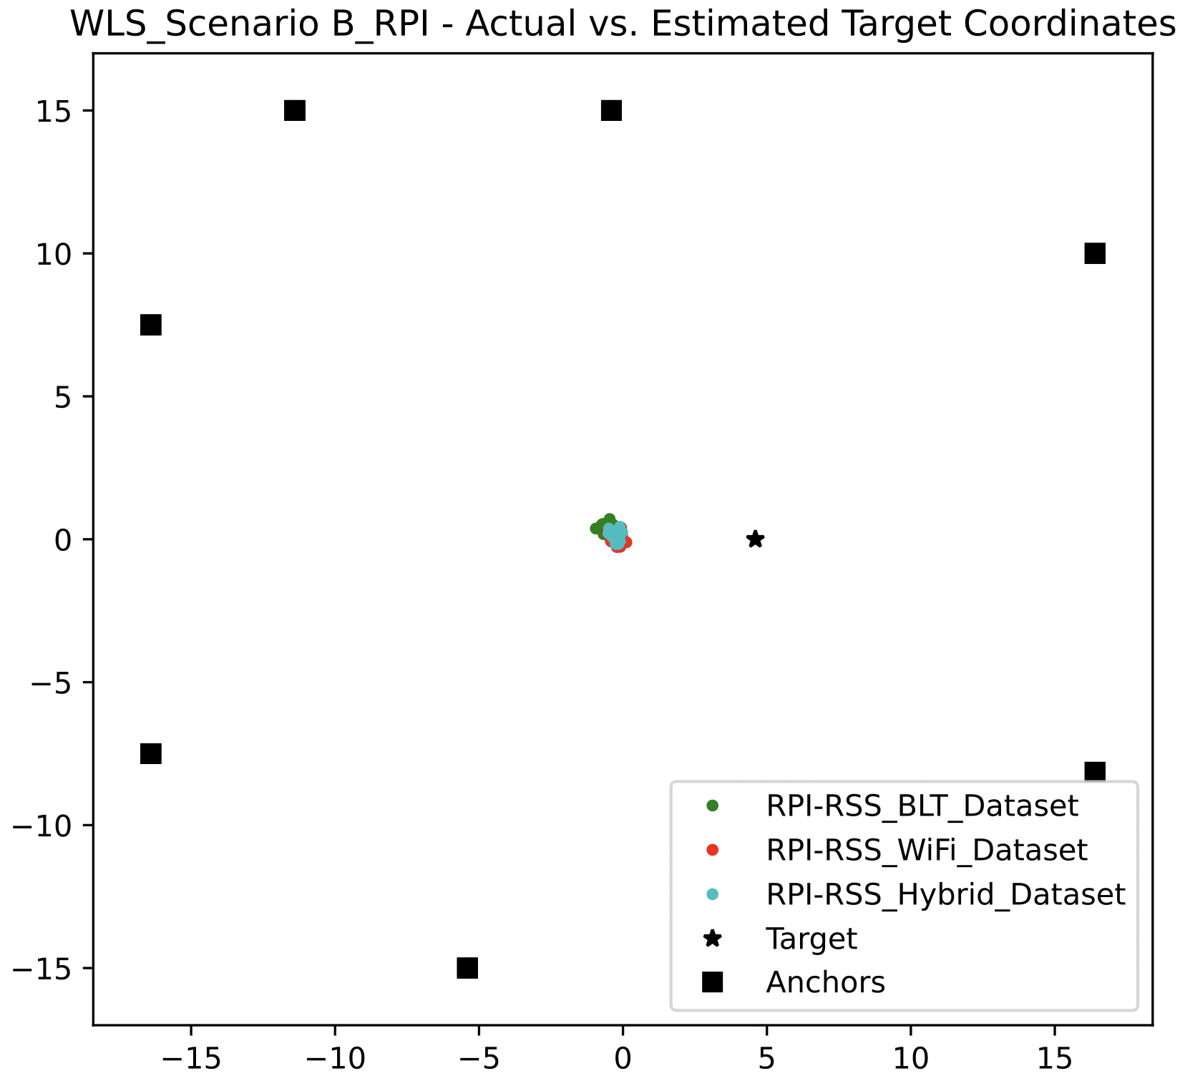
Scenario B (WLS)
RMSE comparison
Inaccurate compared to other scenarios
Still wifi most accurate
BLT | WiFi | Hybrid
5.15 | 4.845 | 4.881

Slide 21
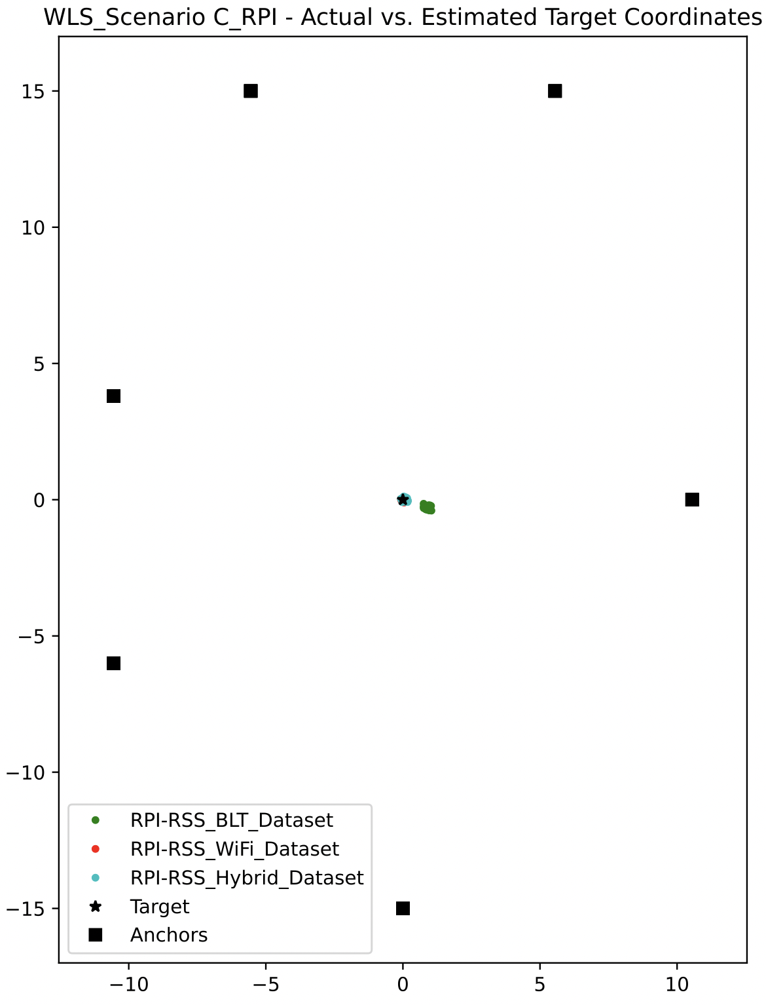
Scenario C
(WLS)
RMSE comparison
Wifi most accurate
BLT | WiFi | Hybrid
0.913 | 0.084 | 0.095

Slide 22
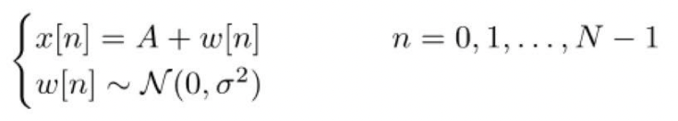
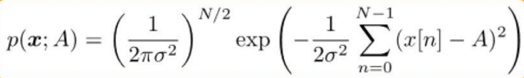
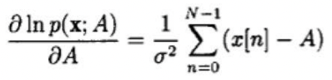
Maximum likelihood estimation
Data points normally distributed with
A actual power and x[n] measured [3]
The likelihood function [3]
The log likelihood [3]
Minimize with Nelder Mead method and initial guess [1,2]

Slide 23
Comparison ML estimation
We compare wifi, bluetooth and hybrid with the Rooted Mean Squared Error. [1]
RMSE equation

Slide 24
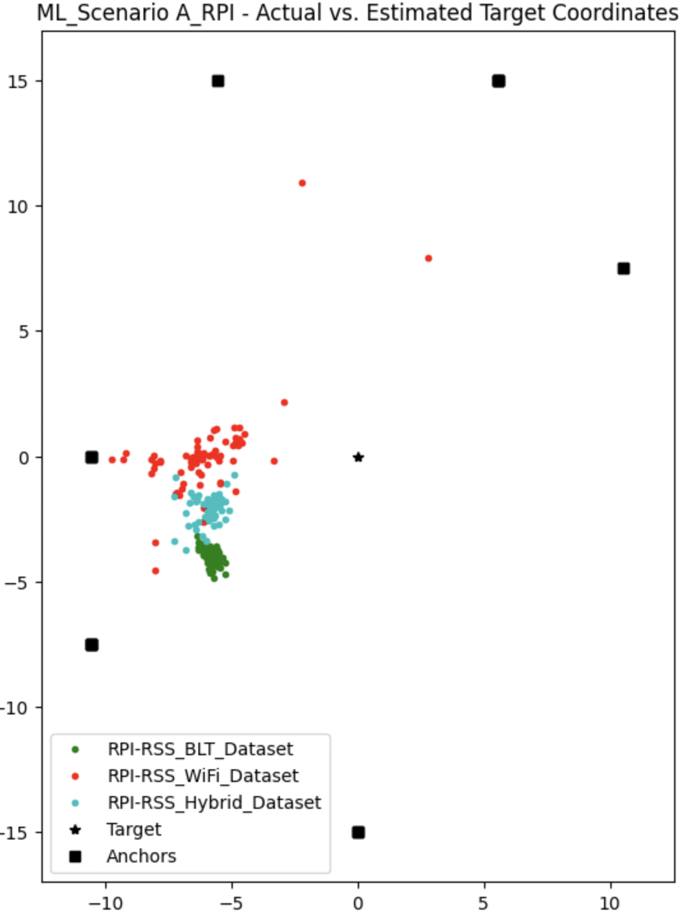
Scenario A
(ML)
RMSE comparison
Wifi more accurate
BLT | WiFi | Hybrid
7.12 | 6.63 | 6.38

Slide 25
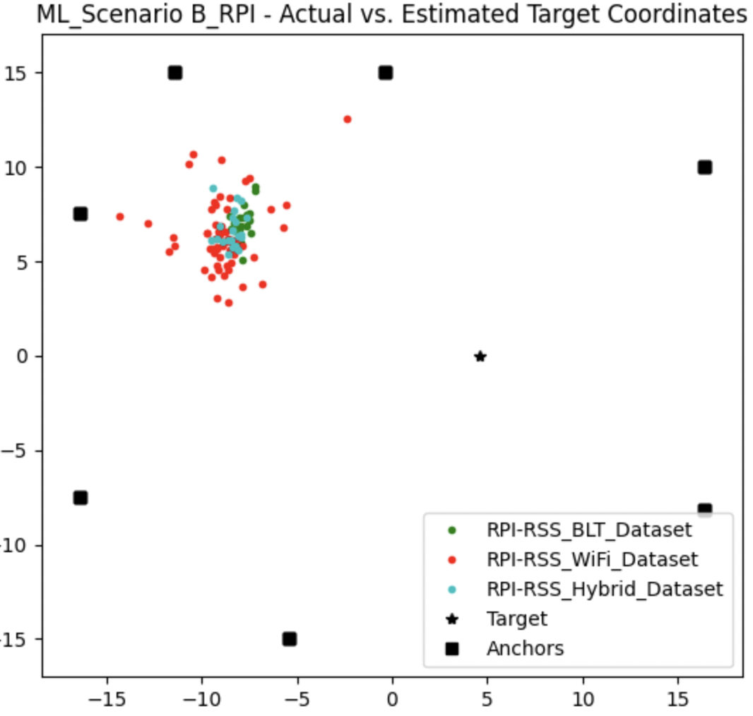
Scenario B
(ML)
RMSE comparison
Equally accurate
BLT | WiFi | Hybrid
14.35 | 15.13 | 14.66

Slide 26
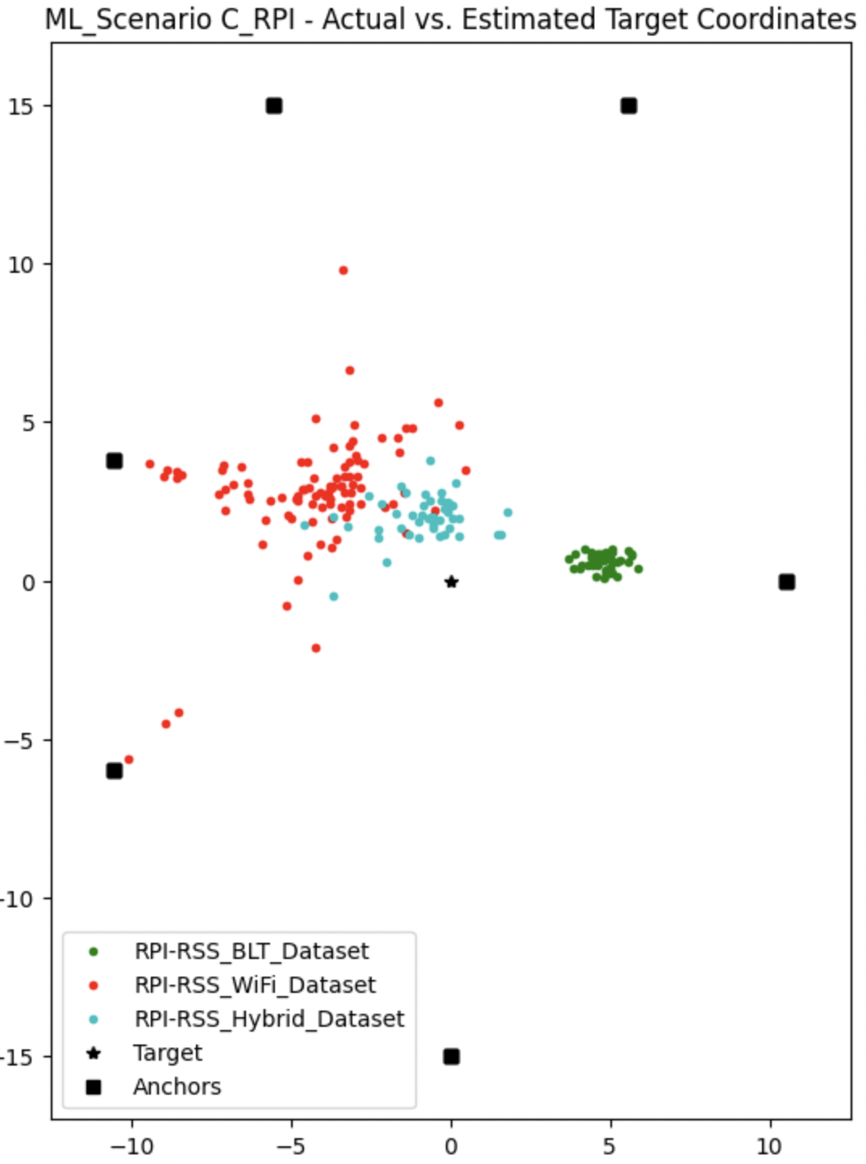
Scenario C
(ML)
RMSE comparison
Wifi better of the two
Hybrid best
BLT | WiFi | Hybrid
4.84 | 5.87 | 2.64

Slide 27
Conclusion
The datasets from WiFi measurements have larger variance than from BLT measurements
The results of the path loss parameters vary a lot from the ones in [1]
Generally WLS estimator provides better results than the ML estimator.
The accuracy of BLT and WiFi methods differ depending of the used estimation technique and Scenario
Overall hybrid provides most consistent estimates
The estimators provide more inaccurate results for Scenario B

Slide 28
References
[1]: Pettorru, G., Pilloni, V. & Martalo, M. (2023). A Hybrid WiFi/Bluetooth RSS Dataset with Application to Multilateration-Based Localization. Department of Electrical and Electronic Engineering, University of Cagliari, Italy. pp. 293-298.
[2]: Gustafson, C., Abbas, T., Bolin, D., & Tufvesson, F. (2015). Statistical modeling and estimation of censored pathloss data. IEEE Wireless Communications Letters, 4(5), 569-572.
[3]: Data Analytics course 2023-2024. Lecture 5: ML estimation. Lecture slides.

